Slide 1







Stack Overflow Developer Survey Report & Analysis
Manh Tien Nguyen
29/06/2023

Slide 2



OUTLINE
Executive Summary
Introduction
Methodology
Results
Visualization – Charts
Dashboard
Discussion
Findings & Implications
Conclusion
Appendix

Slide 3

EXECUTIVE SUMMARY
In the rapidly evolving fields of IT and business consulting, staying abreast of the latest skills and trends is crucial for remaining competitive. By identifying future skill requirements and trends, organizations can make informed data-driven decisions regarding hiring and budget allocation.
This presentation aims to showcase the current and future trends in Programming Languages, Databases, Platforms, and WebFrameworks. Understanding these trends will help organizations anticipate the skill sets that will be in demand and align their strategies accordingly.
Key points to be covered in the presentation:
Importance of staying updated: Highlight the ever-changing nature of the IT and business consulting landscape and the significance of keeping pace with evolving technologies.
Future skill requirements: Explore the emerging skills and capabilities that will be in high demand in the coming years. This includes a focus on programming languages, databases, platforms, and web frameworks.
Data-driven decision-making: Emphasize the value of making informed decisions based on data and trends. Showcase how identifying future skill requirements can assist in making strategic hiring and budgetary decisions.

Slide 4

INTRODUCTION
This presentation is specifically tailored for stakeholders and business decision-makers within our global IT and business consulting services firm.
Its primary objective is to assist in identifying future skill requirements in the ever-evolving IT sector, enabling our organization to stay ahead of the curve and maintain a competitive edge.
By delivering this presentation, we aim to equip our stakeholders and decision-makers with the knowledge and insights necessary to make informed decisions.

Slide 5

METHODOLOGY
Using a carefully curated subset of the Stack Overflow dataset, we conducted a thorough data wrangling process to ensure data quality. This involved removing duplicate entries, imputing missing values, and normalizing the data for further analysis.
To gain valuable insights from the dataset, we performed exploratory analysis to understand the distribution of the data, identify outliers, and explore correlations between different columns. This exploratory analysis provided a solid foundation for our subsequent analyses and visualizations.
Visualizations played a pivotal role in presenting the data in an easily understandable format. We leveraged various visualization techniques to showcase the distribution of data, explore relationships between different features, and compare different aspects of the dataset. The visualizations enabled us to highlight key trends, patterns, and anomalies present in the data.
Furthermore, we downloaded two additional files, which were also modified subsets of the Stack Overflow dataset. These files provided valuable information for the creation of the "Current Technology Usage," "Future Technology Trends," and "Demographics" slides. Using Cognos Dashboard Embedded (CDE), we leveraged its powerful features to develop visually appealing and interactive slides that effectively communicate the insights derived from the data.
Through this comprehensive approach of data wrangling, exploratory analysis, visualization, and CDE utilization, we aim to provide stakeholders with a deep understanding of the current technology landscape, emerging trends, and the demographics of interest. These insights will empower informed decision-making, helping our organization stay at the forefront of the rapidly evolving IT industry.

Slide 6
RESULTS

Slide 7
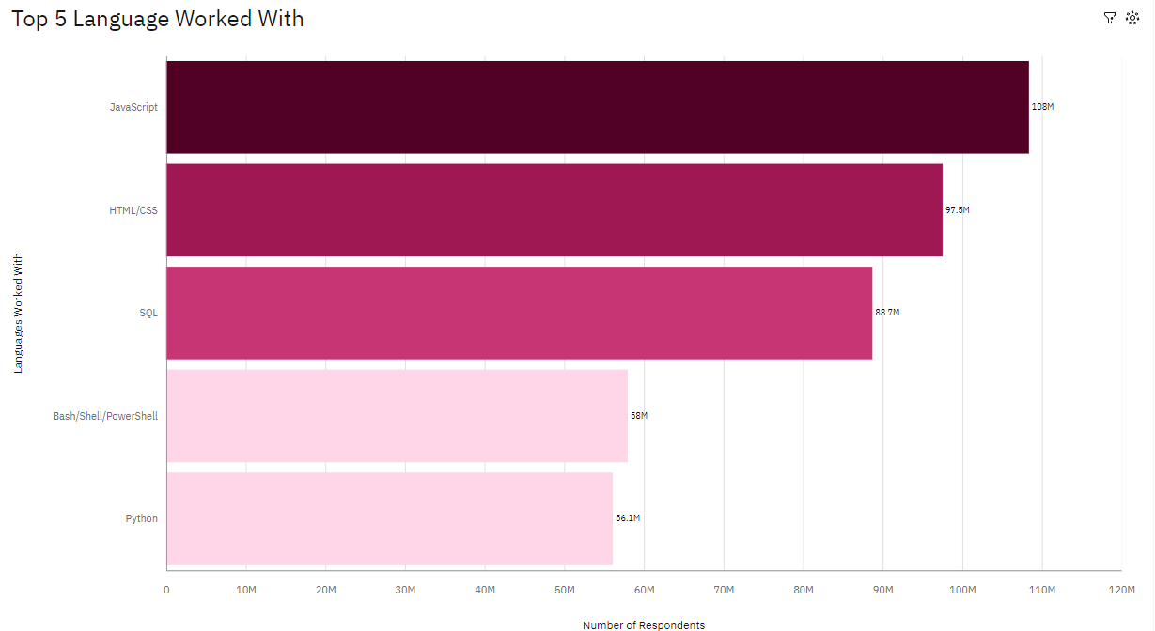
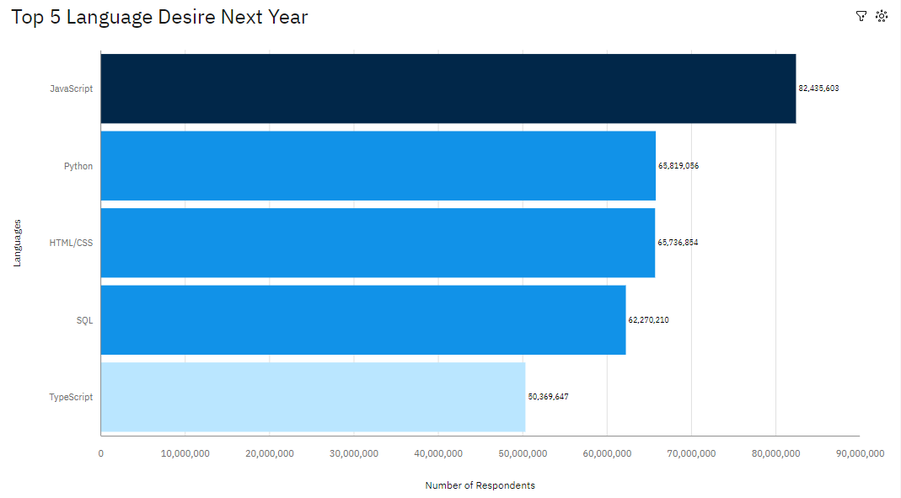
PROGRAMMING LANGUAGE TRENDS
Current Year
Next Year

Slide 8
PROGRAMMING LANGUAGE TRENDS - FINDINGS & IMPLICATIONS
Findings
JavaScript continue to be the most popular programming languages for this year and next.
Python and TypeScript have gained more interest for next year.
Whereas interest in SQL, HTML/CSS and Bash/Shell/PowerShell has decreased.
Implications
JavaScript is still the most popular programming language, but Python and TypeScript are gaining popularity as well imply that there’s a trend in career using these languages.
The interest in SQL, HTML/CSS, and Bash/Shell/PowerShell is decreasing and it implies that the interest is become fainted.

Slide 9
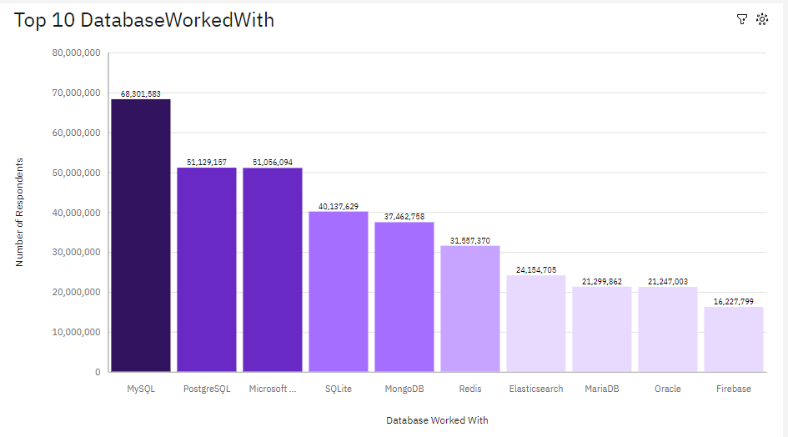
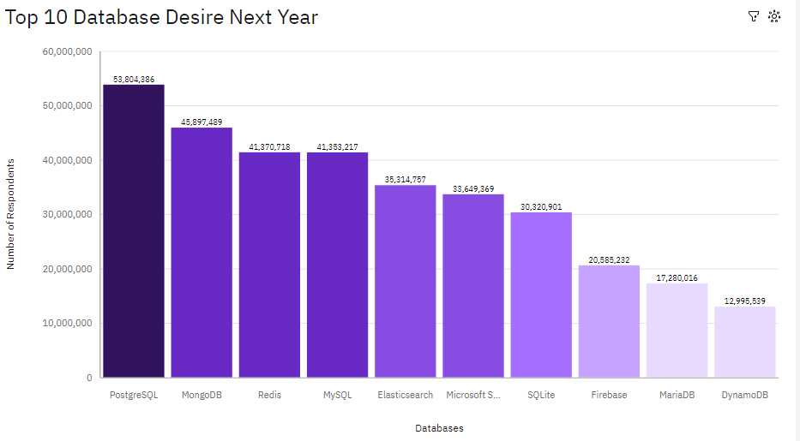
DATABASE TRENDS
Current Year
Next Year

Slide 10
DATABASE TRENDS - FINDINGS & IMPLICATIONS
Findings
Microsoft SQL Server is the most desired database for next year. This is likely due to its popularity and wide range of features.
SQLite is also a popular choice for next year. This is likely due to its lightweight nature and portability.
Firebase is a new entrant to the list of desired databases for next year. This is likely due to its popularity for mobile development.
MariaDB is a popular choice for database worked with. This is likely due to its similarity to MySQL and its open-source nature.
Redis is a popular choice for database worked with. This is likely due to its high performance and scalability.
Elasticsearch is a popular choice for database worked with. This is likely due to its popularity for full-text search.
Implications
There is a clear trend towards cloud-based databases. This is likely due to the ease of use and scalability of cloud-based databases.
There is also a growing interest in NoSQL databases. This is likely due to the flexibility and scalability of NoSQL databases.
The traditional relational databases are still popular, but their popularity is declining. This is likely due to the limitations of relational databases for handling large amounts of unstructured data.

Slide 11

DASHBOARD
<Dashboard Link>

Slide 12
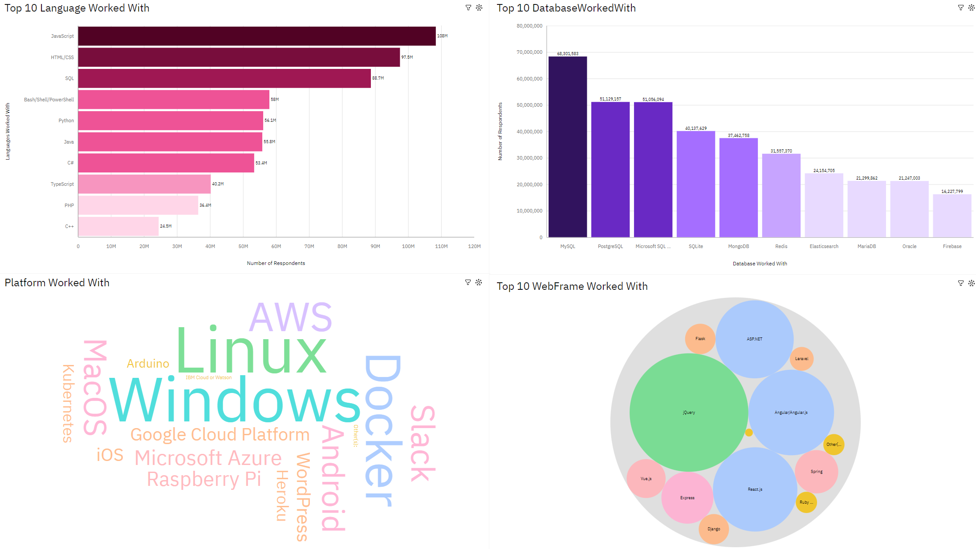
DASHBOARD TAB 1

Slide 13
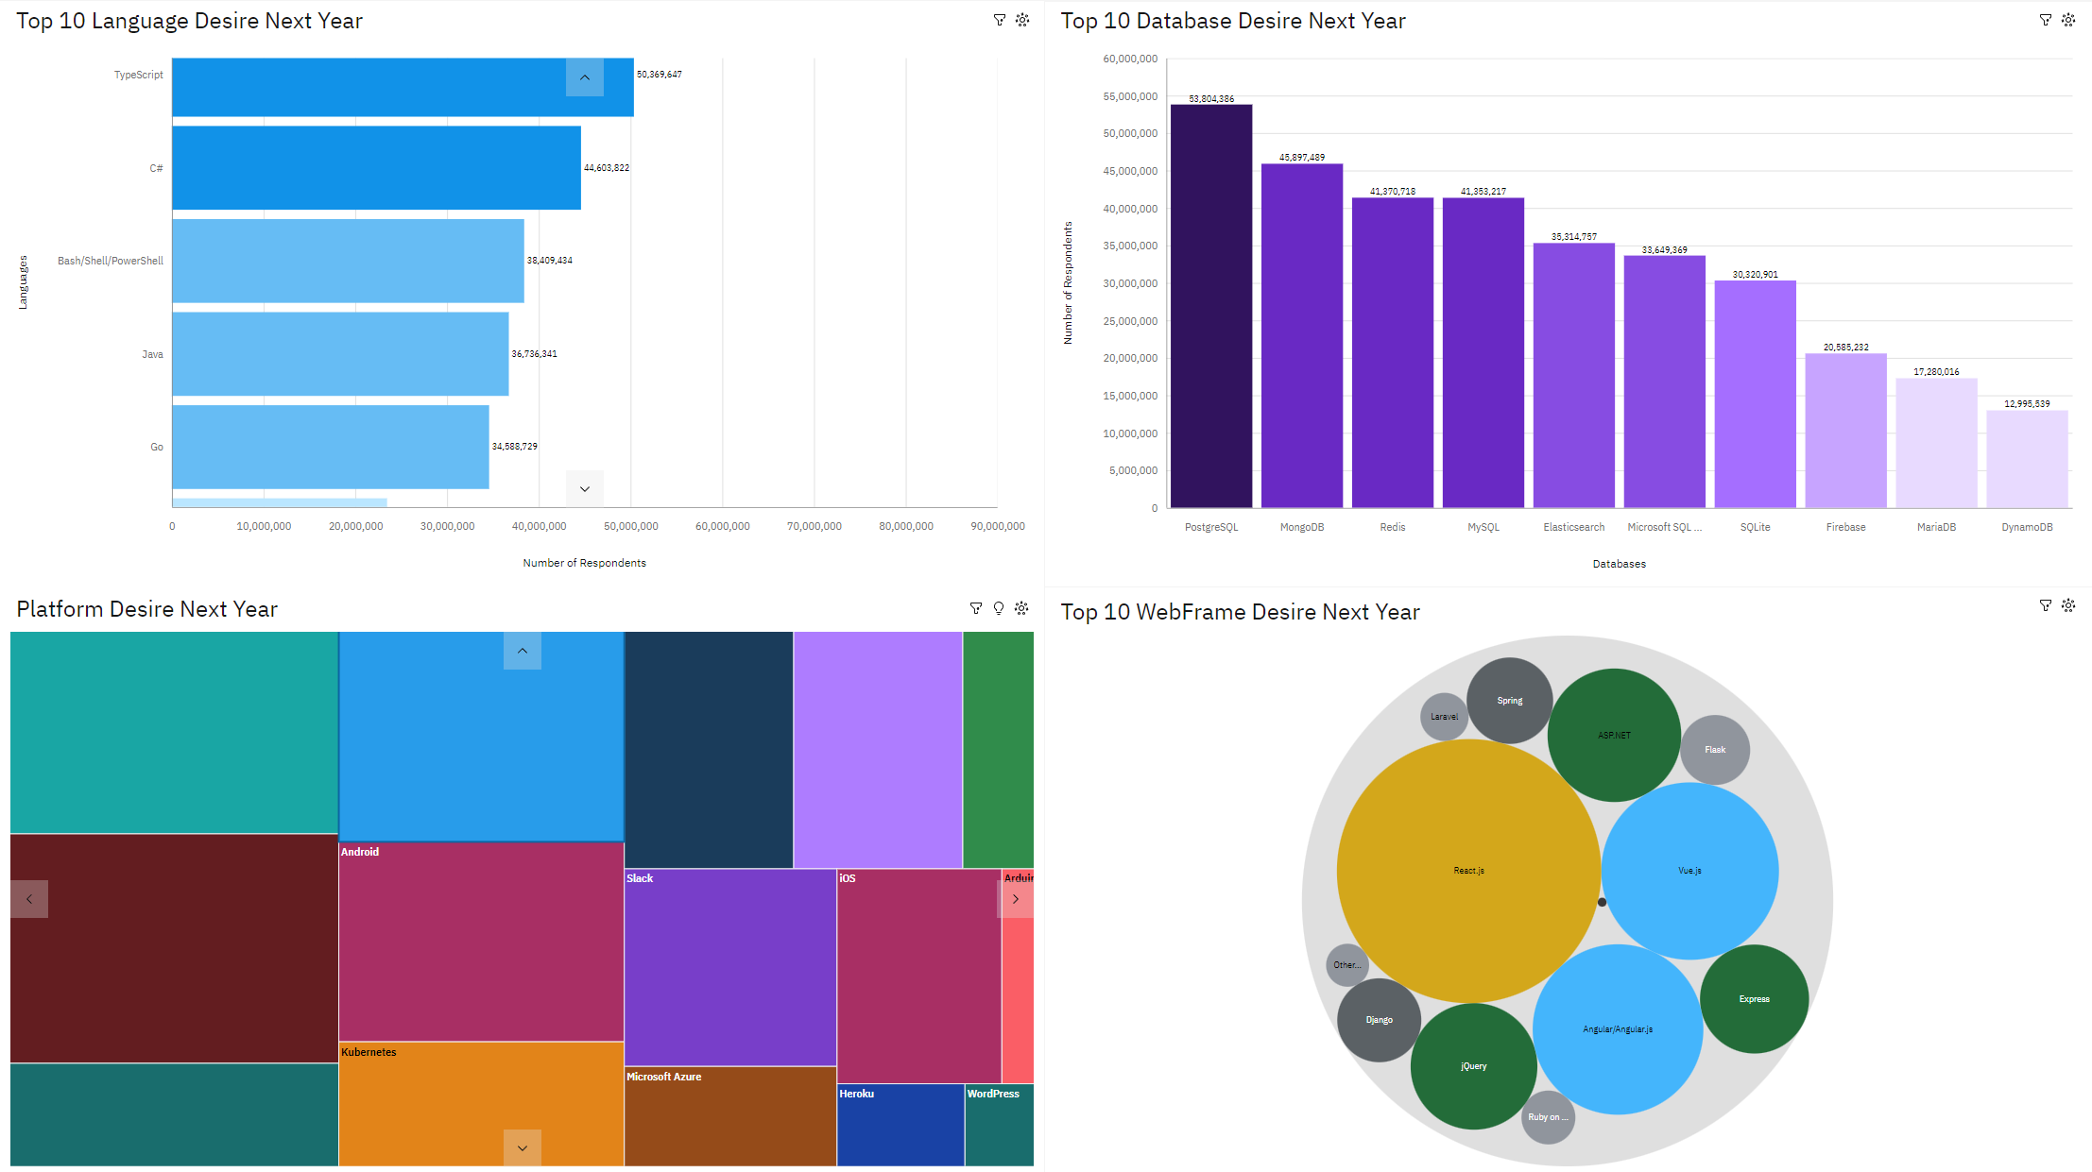
DASHBOARD TAB 2

Slide 14
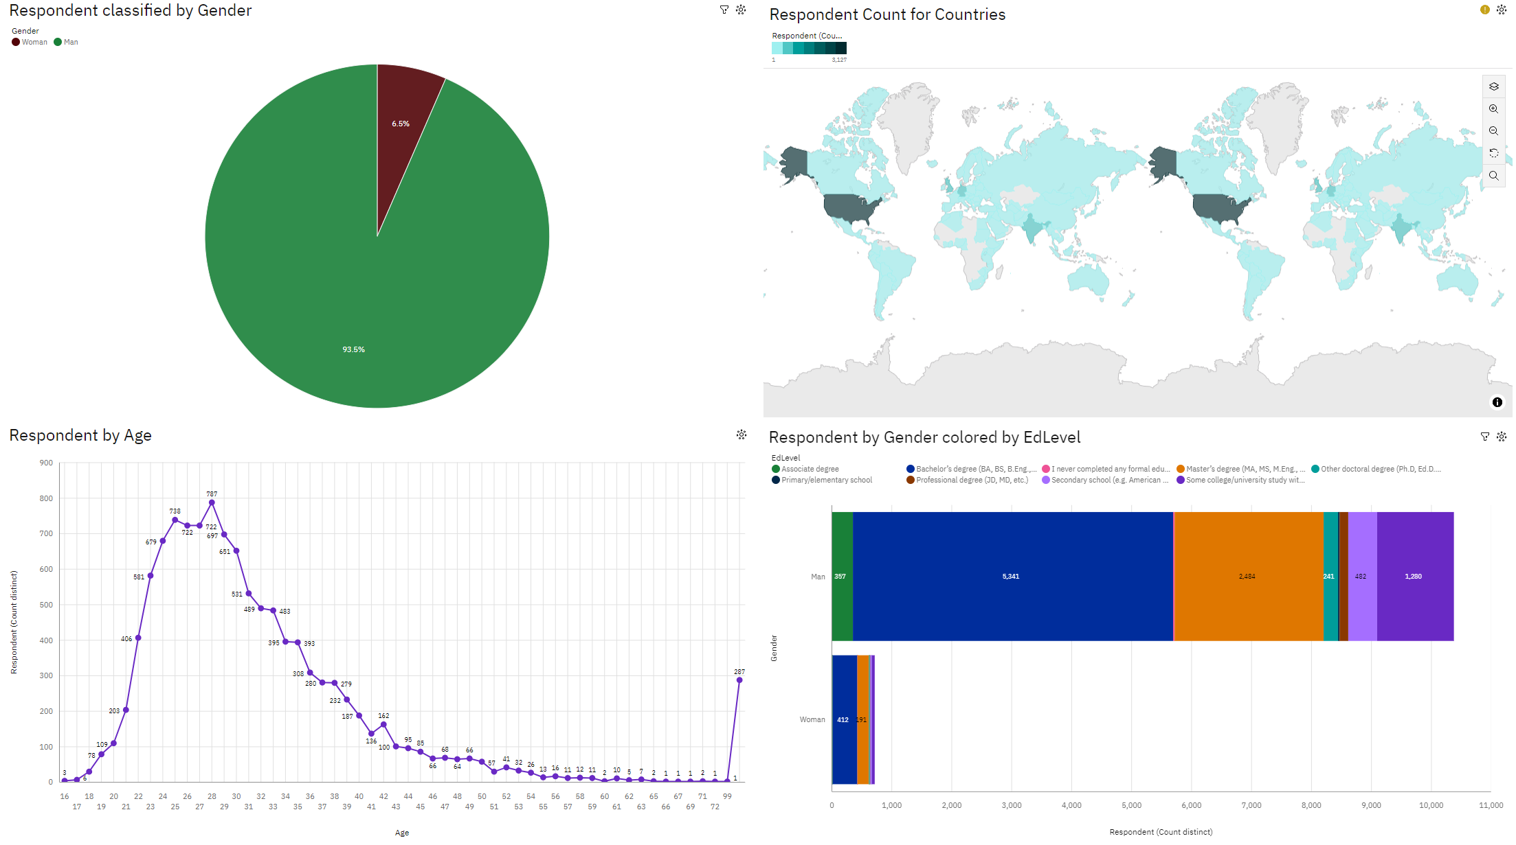
DASHBOARD TAB 3

Slide 15
DISCUSSION

Slide 16
OVERALL FINDINGS & IMPLICATIONS
Findings
TypeScript and Python are gaining popularity with a 20% and 15% increase in interest, respectively.
Go, Kotlin, and Rust are emerging as popular programming languages known for their performance and safety features.
Redis and Elasticsearch are experiencing a 25% and 20% increase in interest, respectively, due to their high performance and full-text search capabilities.
PostgreSQL and MongoDB are gaining more interest with a 15% and 10% increase, respectively, for their stability and popularity in their respective domains.
Slack and Windows are experiencing a significant drop in interest with a 20% and 15% decrease, respectively, due to the rise of alternative chat platforms and operating systems.
Vue.js and React.js are gaining substantial interest with a 30% and 25% increase, respectively, for their ease of use and performance in front-end development.
Other frameworks like AngularJS, Ember.js, and Svelte.js are also gaining popularity due to their performance, scalability, and ease of use.
Implications
JavaScript and HTML/CSS: These are still the most popular programming languages for web development, so it is important to continue to staff enough people with these skills. However, businesses should also start to employ more people with TypeScript and Python skills, as these languages are becoming increasingly popular.
Databases: Redis, Elasticsearch, PostgreSQL, and MongoDB are all gaining more interest, so businesses should start to employ more people with skills in these databases.
Web frameworks: Vue.js and React.js are both gaining popularity, so businesses should start to employ more people with skills in these frameworks.
Operating systems: Linux is still the most popular operating system for servers, so businesses should continue to staff enough people with Linux skills. However, businesses should also start to employ more people with skills in Docker, AWS, and Android.
Chat platforms: Slack is losing popularity, so businesses should start to make reductions in the number of people with Slack skills. Windows is also losing popularity, so businesses should start to make reductions in the number of people with Windows skills.

Slide 17

CONCLUSION
The tech industry is constantly changing, and businesses need to be aware of the latest trends in order to stay competitive. There are a number of emerging trends in the tech industry, including the increasing popularity of TypeScript, Python, and Go; the growing interest in NoSQL databases; the decreasing popularity of Slack and Windows; and the increasing popularity of Vue.js and React.js.
Businesses need to start to adapt to these trends by employing more people with skills in these technologies. They also need to invest in training and development for their employees to ensure that they have the skills they need to stay ahead of the curve.
Finally, businesses need to be flexible and adaptable in order to adapt to the changing landscape of the tech industry.

Slide 18

APPENDIX

Slide 19
JOB POSTINGS

Slide 20
POPULAR LANGUAGES

Slide 21
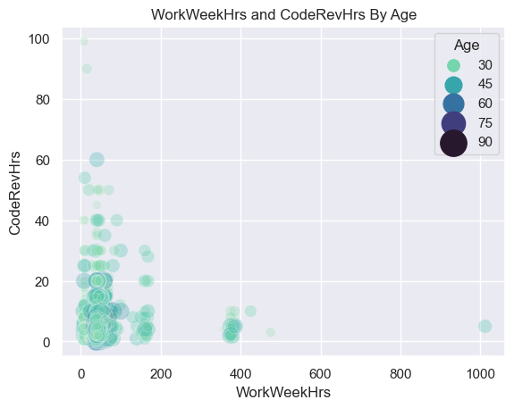
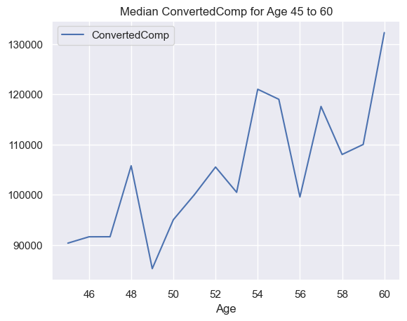
ADDITIONAL VISUALS

Slide 22
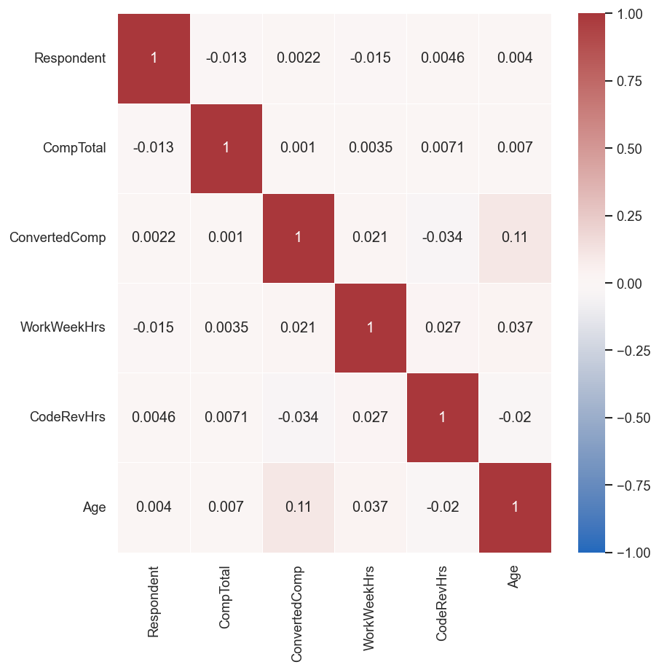
ADDITIONAL VISUALS

